Slide 2
ML Best Practices
Yanxi Pan

Slide 3
Outline
Label
Data
Features
Model
Experimentation

Slide 4
Label
Define the problem

Slide 5
Label
Choose a simple and observable metric as your label
Was this ad clicked or not
Was this post liked or not
If there is no observable data, use human raters
Use crowdsourcing like Mturk to get labels
It’s important to have a consistent definition

Slide 6
Data
Garbage In Garbage Out

Slide 7
Things to consider
Unrealistic / unreasonable data
Missing data

Slide 8
Unrealistic / unreasonable data
Example: Users give random price for the items they sell on marketplace. A luxury Sedan for free!
Solution: Clean the data. Remove top 1% and bottom 1% of data.

Slide 9
Missing data
Example: Some users don’t want to share their data or new users don’t have any data yet (browsing history, ratings etc).
Solution: Use priors (mean, median, smoothing etc)

Slide 10
Things to consider (cont’d)
Data volume
Sparsity

Slide 11
Data volume
Is the data enough to train your model?
The number of feature weights you can learn in a linear model is roughly proportional to the amount of data you have. More complex models need more data.

Slide 12
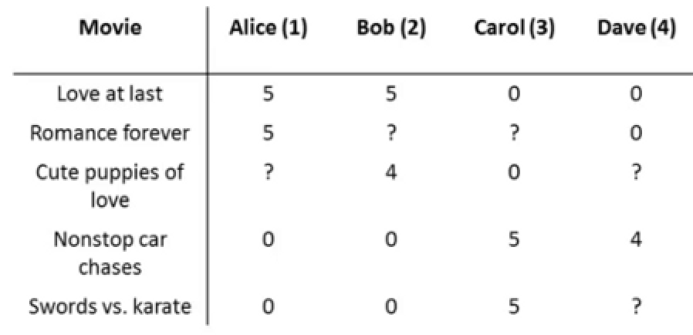
Sparsity
Big data? Or a collection of small data?
Example: movie ratings
Solution: latent factor models, matrix factorization. Learn a shared representation and reduce the dimension.

Slide 13
Things to consider (cont’d)
Biased data
Unbalanced data

Slide 14
Biased data
Example: Users tend to have different behavior (CTR) if we show the same post at different positions.
Solution: Re-sample the data so that CTR is the same at all positions.

Slide 15
Unbalanced data
Example: When predicting rare events like negative feedbacks, positives (xout) are much less than negatives.
Solution: downsample negatives

Slide 16
Features
Right feature processing makes modeling easier

Slide 17
Features
Normalization
Transformation
Feature selection

Slide 18
Normalization
The scale of different features varies a lot. Some objective functions will not work well without normalization. If one feature has a large scale, the function will be dominated by this feature.
Example: Use ctr and price as features in marketplace recommendation.
Solution: Standardization, scaling to unit vector.

Slide 19
Transformation
Example 1: Categorical features like country, age group.
Solution: Convert them to a set of binary features.
Example 2: Text features like item description.
Solution: Bag of words representation.

Slide 20
Feature selection
Motivation:
Simplify the models, reduce feature space.
Train faster
Better generalization
Methods: Use regularization to remove correlated features. Only keep the most important features in the model.

Slide 21
Model
Be systematic and pay attention to details

Slide 22
Model
Hyper-parameter tuning
Properly split up the data to evaluate models
Model iteration workflow

Slide 23
Hyper-parameter tuning
Can make a big difference!
Learning rate, regularization factor etc
Algorithms:
Grid search
Random search
Bayesian optimization

Slide 24
Split up the data
Train the model on train distribution
Tune hyper-parameters on a validation set
Evaluate models on test set – application distribution
Train
Validation
Test

Slide 25
Model iteration workflow
Problem | Reason | Solution
Training error is high | High bias / underfitting | More features More complex model
Validation error is high | High variance / overfitting | More training data Smaller set of features
Test error is high | Distribution mismatch Overfit hyper-parameters | Domain adaptation More validation data

Slide 26
Experimentation
Test one change at a time

Slide 27
Experimentation
Test infra separately from machine learning models
Start with a simple model to make debugging easier
Try to isolate the effect from each change

Slide 28
Summary
Data is critical
Start with something simple and solid, then iterate
Systematic and persistent - don’t take things for granted

Slide 29
Thanks
Q&A

